Slide 1
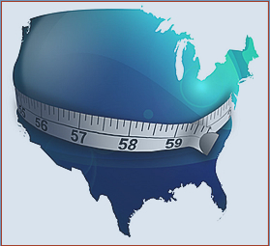
Obesity in America
Nina Netupsky

Slide 2
Prevalence of Obesity in America
Over the past 30 years the number of individuals that have been diagnosed with obesity has increased more than 50%.
Currently, two-thirds of Americans are either overweight or obese.
There are nearly 300,000 fast food chains in America.
The fast food industry is forecast to continue to grow by approximately 4% each year.
Only about half of Americans exercise regularly (at least three sessions a week for 30 minutes at a time), and the percentage of exercisers has declined since 2008.

Slide 3
What are Contributing Factors to Obesity in America?
Variables:
Population: 50 States
Obesity Prevalence: Percentage of obese individuals per state
Participation in Physical Activity: Data represent adults who reported that they participate in 150 minutes of physical activity per week.
Number of Fast Food Restaurants (FFR)
Percentage of Fast Food Restaurants per 1000 Residents
Median Income per State
Notes:
Probability plots were constructed for each variable to attain p-values. All p-values are greater than 0.05, except number of fast food restaurants, indicating the data is normal and linear.

Slide 4
I. General Relationships
Comparing Obesity Prevalence to Variables: Parametric Procedures
Regression Analysis and Fitted Line Plots

Slide 5
Regression Analysis: Obesity vs. FFR
Obesity Prevalence = 27.90 - 0.000073 FFR
S = 3.05891 R-Sq = 1.4% R-Sq(adj) = 0.0%
Analysis of Variance
Source DF SS MS F P
Regression 1 6.478 6.47794 0.69 0.409
Error 49 458.490 9.35693
Total 50 464.967
Regression Analysis: Obesity % vs. FFR per 1000 Residents
Obesity Prevalence = 35.33 - 10.07 Fast Food Restaurants per
S = 2.64144 R-Sq = 26.5% R-Sq(adj) = 25.0%
Analysis of Variance:
Source DF SS MS F P
Regression 1 123.083 123.083 17.64 0.000
Error 49 341.884 6.977
Total 50 464.967

Slide 6
Regression Analysis: Obesity % vs. PPA: Percentage of adults that report doing physical activity for at least 150 minutes a week.
Obesity Prevalence = 49.79 - 0.4324 PPA
S = 1.97900 R-Sq = 58.7% R-Sq(adj) = 57.9%
Analysis of Variance
Source DF SS MS F P
Regression 1 273.063 273.063 69.72 0.000
Error 49 191.905 3.916
Total 50 464.967
Regression Analysis: Obesity % vs. Median Income
Obesity Prevalence = 40.48 - 0.000252 Median Income
S = 2.41339 R-Sq = 38.6% R-Sq(adj) = 37.4%
Analysis of Variance:
Source DF SS MS F P
Regression 1 179.568 179.568 30.83 0.000
Error 49 285.399 5.824
Total 50 464.967

Slide 7
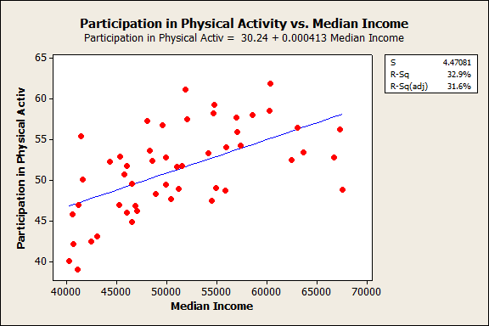
Notes:
P value = 0.000

Slide 8
Do Regions Share Similar Obesity Percentages?
Nonparametric Procedure: Kruskall-Wallis: Show there is no significant difference among median percentage obese within region.
H₀ : [τ₁ = τ₂ = τ₃ = τ₄] vs. H₁ : [τ₁ = τ₂ = τ₃ = τ₄, not all equal]
Summarized Kruskall-Wallis Statistics:
Region | Median Percentage Obese | H Statistic | DF | P-Value
Western | 24.7 | 12 | 12 | 0.446
Midwest | 28.7 | 11 | 11 | 0.443
Northeast | 25.4 | 8 | 8 | 0.433
Southern | 30.4 | 15 | 15 | 0.451

Slide 11
Nonparametric Measure of Association and Correlation:
Kendall’s Tau & Spearman’s Rank
Kendall’s Tau: All variables proved to have significant negative correlations.
Spearman’s Rank: Significant Association among variables.

